Slide 1
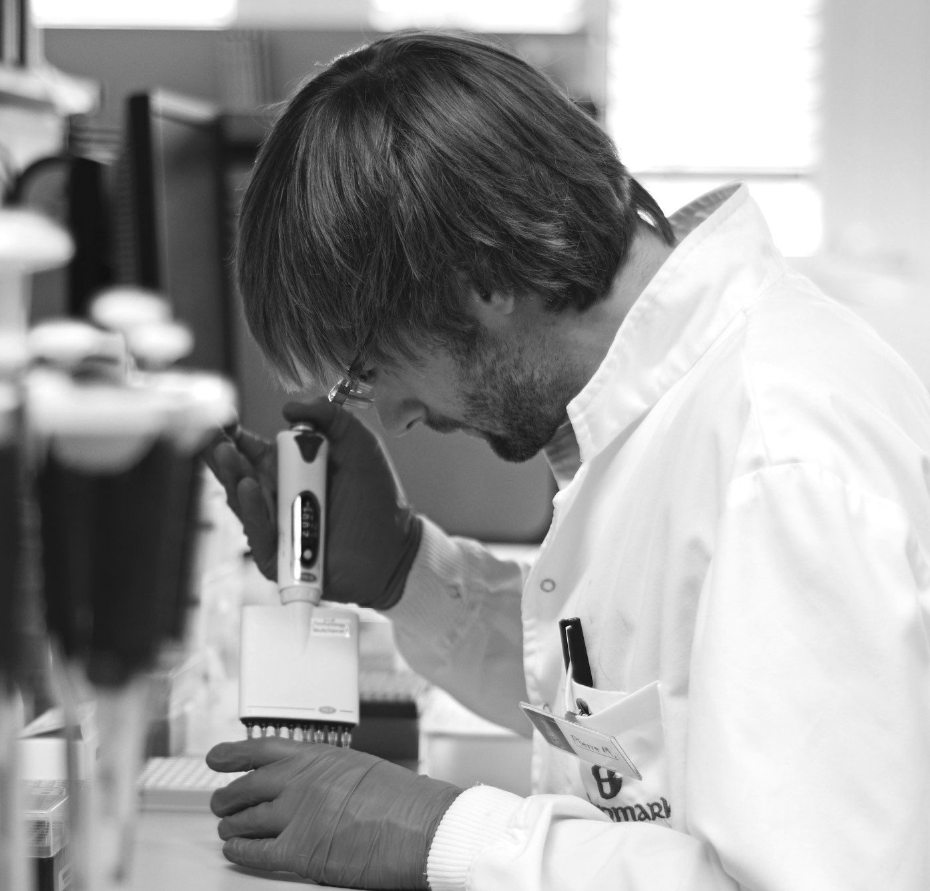
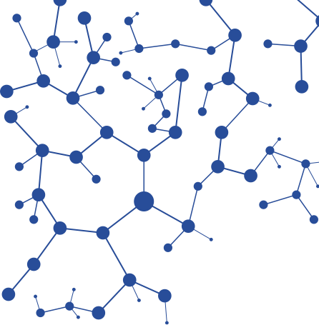


Q3 FY22
Investor Presentation
Glenmark Life Sciences Ltd

Slide 2

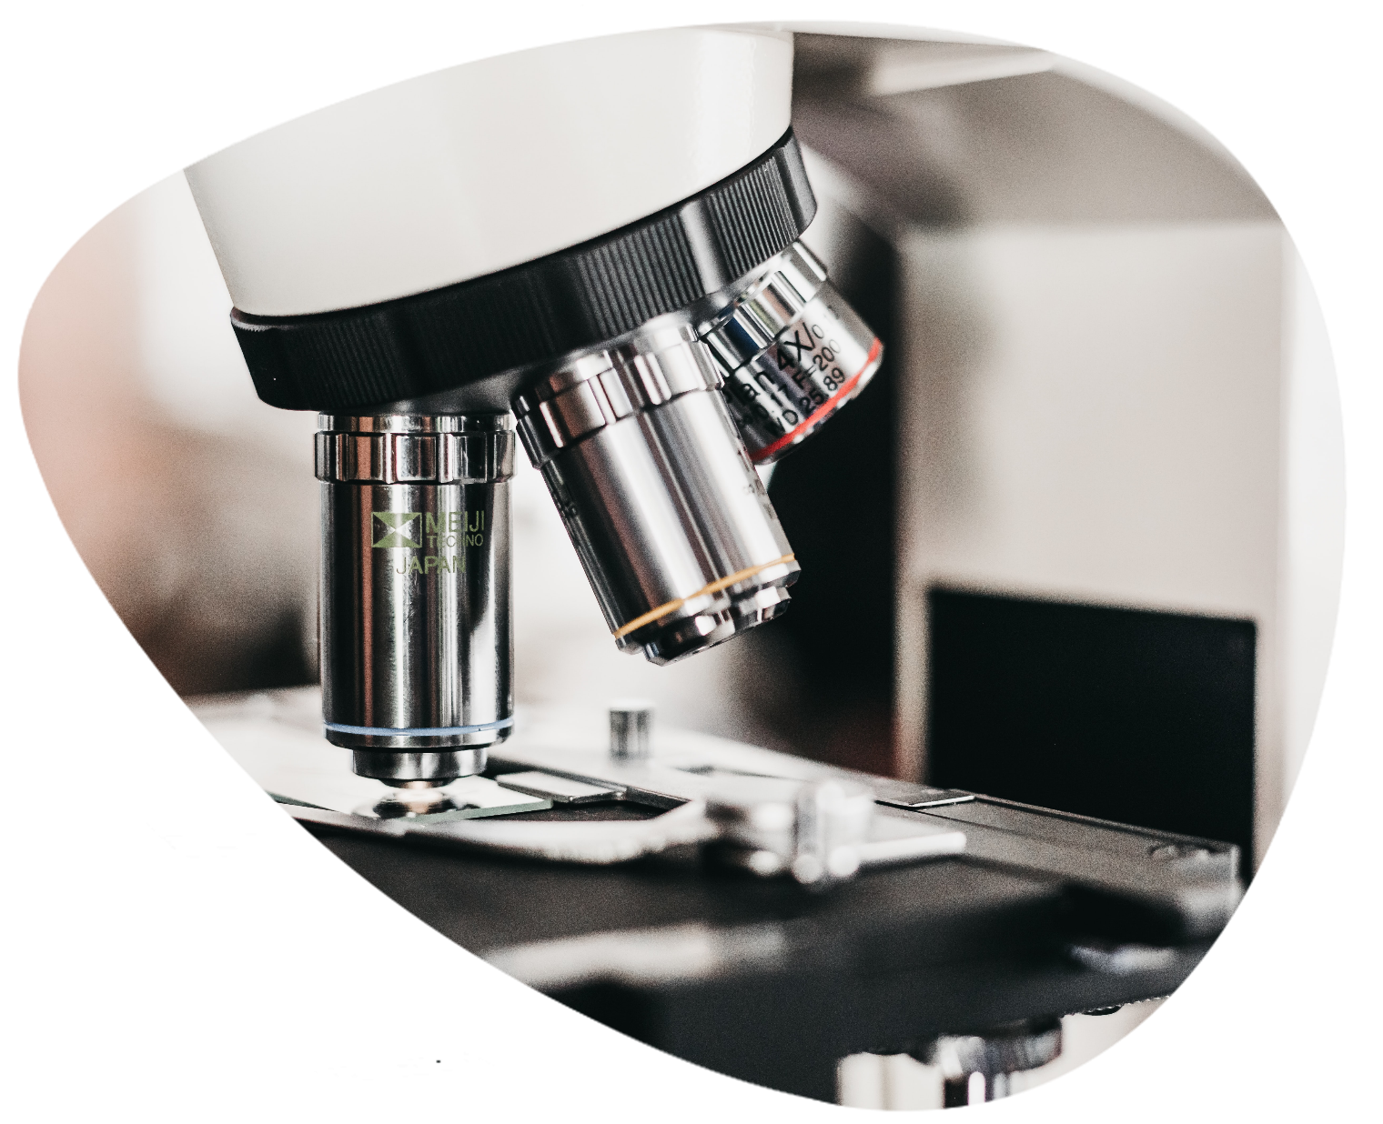
01
Financial Performance Review

Slide 3
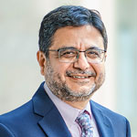

Q3 FY22 – Highlights
YoY Revenue grew at 4.5% in Q3 and 13.5% in 9M FY 22.
CDMO business is growing at 45.1% in Q3 and 30.9% in 9M FY 22
During the quarter, revenues from the regulated markets witnessed healthy growth whereas revenues from the emerging markets were lower due to high base of COVID products sales last year
EBITDA margins for the quarter were at 28.6%, compared to 30.2% in Q2 FY22 and 31% during Q3 of FY21
R&D expenditure at 2.9% during the quarter and 2.7% for 9M FY22
PAT margins improved following debt repayment
Dr. Yasir Rawjee
Managing Director and Chief Executive Officer
“We have delivered a steady performance in Q3FY22 with a healthy EBITDA margin. While the generic API business growth was muted due to the base effect of COVID API sales last year, we continued our strong momentum in the CDMO business fuelled by healthy demand and growth in the regulated markets. Our overall results reflect our operational resilience.”
YoY 11.1%

Slide 4
P&L Highlights – Q3 & 9M FY22

Slide 5
Quarter on Quarter Performance
Sustaining a profitable growth trajectory
Revenue
EBITDA
PAT
EPS
Amounts in INR Millions except EPS

Slide 6
Financial Performance Track Record
Robust growth and profitability indicators over the years
Revenue
EBITDA
PAT
EPS
Note: Numbers of FY18 and FY19 are based on Proforma Financials.
Amounts in INR Millions except EPS

Slide 7
Strong Returns Indicators
ROCE is tracking at 31% for 9M FY22.
FATR is 3.6 times for 9M FY22.
Continuous improvement in working capital cycle , WC days improve to 152 days
Note: FATR and ROCE for 9M FY22 are annualised. Numbers of FY18 and FY19 are based on Proforma Financials. ROCE is calculated as EBIT/ Closing capital employed

Slide 8
02
Business Performance Review

Slide 9
Segment Performance
0.9% YoY
-6.6% QoQ
45.1% YoY
-17.3% QoQ
Generic API
CDMO
Generic API revenues in Q3FY22 increased 0.9% YoY, low growth is largely due to COVID portfolio sales in the base
Revenues grew 12.0% YoY in 9M FY22
Robust growth in LATAM, North America and Japan
CDMO revenues registered strong growth of 45.1% YoY in Q3 FY22 and 30.9% in 9 M FY22
3 commercial projects with multinational and specialty pharmaceutical companies
4th project to be commercial by Q3 FY23
Multiple discussions ongoing with companies globally for additional business opportunities

Slide 10
Market and Therapeutic Area Mix
Market Mix
Therapeutic Area Mix
Regulated markets account for ~72% of Net Sales in 9M FY22, growing at 28.3% YoY
Emerging markets account for 28% of Net Sales in 9M FY22, declining at 12.7% YoY
Products from key Chronic Therapeutic Areas (viz CVS, CNS, Diabetes, Pain management) account for 62.3% of Net Sales in 9M FY22, growing at 19.1% YoY.
Others are mainly acute segment with wide range of therapies

Slide 11
03
Company Overview

Slide 12
Global Footprint
Filed 418 DMFs and CEPs across major markets; United States, Europe, Japan, Russia, Brazil, South Korea, Taiwan, Canada, China and Australia
ROW
50+
330+
30+
83
113
145
10+
16
100+
50+
61
(Brazil)
Regulated Markets
Emerging Markets
India – Mix of Regulated
and Emerging
Number of
DMF/CEP filings
Number of customers
serviced in FY21
As of December 31, 2021

Slide 13
Quality-focused, compliant manufacturing & R&D infrastructure
Manufacturing Infrastructure
R&D Infrastructure
 | Annual Installed Capacity (Mar-21) | Last USFDA Inspection Date | Approvals
Ankleshwar, Gujarat | 550.2 KL | July 2019 | USFDA, MHRA (UK), FIMEA (Finland), Romania (Europe) PMDA (Japan), COFEPRIS (Mexico), Health Canada, KFDA (South Korea), Gujarat FDCA
Dahej, Gujarat | 141.9 KL | Oct 2018 | USFDA, EDQM (Europe), PMDA (Japan), KFDA (South Korea)
Mohol, Maharashtra | 49.1 KL | March 2018 | USFDA, Maharashtra FDA
Kurkumbh, Maharashtra | 24.6 KL | -NA- | Maharashtra FDA
Mahape, Navi Mumbai
R&D for new product development and complex molecules
High-end analytical equipment for characterization
Ankleshwar, Gujarat
Cost improvement programs and process improvements
Dahej, Gujarat
Oncology R&D
Cost improvement programs and process improvements

Slide 14
R&D Capabilities
Cumulative Filing Status
6 DMF/CEPs were filled across major markets in Q3 FY22 and 20 DMF/CEPs filled during 9 M FY22 which take cumulative filings to 418 as on 31st Dec’21
~120 Unique molecules in the portfolio across the globe as of 31st Dec’21.
26 products in development pipeline including 4 Iron complex and 7 Oncology products
R&D facilities have 274 personnel constituting 16.9% of total permanent employee strength as of 31st Dec’21

Slide 15
04
Strategy Going Forward

Slide 16
Strategic Growth Levers
  New product launches
  Geographical expansion
  Focus on new markets becoming more regulated
  Pursue 2nd source opportunities with top generic players
  Ramp up CDMO portfolio
  Expand into complex API platforms
    Iron compounds
    Oncology
Gx API Business
New Growth levers
Capacity
Operational efficiencies
    Capacity expansion
      Greenfield – Solapur, 600KL
      Brownfield – Dahej, 200KL
      Oncology block - Dahej
    Backward integration
      400KL,1st plant in Ankleshwar
    Build R&D capability for new growth levers
  Debottlenecking
  2nd/3rd generation process adoption
  Backward integration
  Reduce carbon footprint
  Adoption of flow chemistry in manufacturing
  Pursue AVD opportunities

Slide 17
Future Capacity Expansion Plan
Expansion Type | Division | Location | Current Capacity | Status & Planned Capacity | Operational Timelines
Brownfield | API | Dahej | 141.9 KL | Under Construction 4 Modules -240 KL | Phase I – Q1FY23 Phase II – Q3 FY23
Brownfield | Intermediate | Ankleshwar | 550.2 KL | New plant 400 KL | Q2 FY23
Brownfield | Oncology | Dahej | - | 3 Modules Under Construction | Q1 FY23
Greenfield | API | Solapur | - | Land acquired 800 KL | FY24 – FY26
Backward Integration plant at Ankleshwar is planned
Oncology facility under construction at Dahej
Capacity Progress by Year

Slide 18
Thank You
Glenmark Life Sciences Limited
Corporate Office: 4th Floor, OIA House, 470, Cardinal Gracious Road, Andheri (E), Mumbai, 400 099, India. Registered Oﬃce: Plot No. 170-172, Chandramouli Industrial Estate, Mohol Bazarpeth, Solapur - 413 213, India.
T: 91 22 68297979 CIN: U74900PN2011PLC139963
Email: complianceoﬃcer@glenmarklifesciences.com
Website: www.glenmarklifesciences.com

